Slide 1
Presentation Financial Results for the first 9 months of 2023
- November 2023 -

Slide 2
1. Macroeconomic Context, markets and trends
Context
Tends
$25B
The annual inflation rate of 8.8% (September 2023 vs. September 2022) according to NIS, in a downward trend compared to previous months. Estimated by BNR to reach 7.5% at the end of 2023 and 4.4% by the end of the year 2024.
Monetary policy rate 7.0% (starting 11th of January 2023).
FMCG & HoReCa distribution market reached 25.3 billion lei in 2022 (+18%).
FMCG retail market is estimated to reach RON 130 billion in 2023 (+3.2%).
The HoReCA retail market is estimated to reach RON 19 billion in 2023 (+12%).
Inflation and the growth of Convenience and Supermarkets channels in retail, as well as the HoReCa channel, are the main drivers for sales growth.
The trend of stabilizing volumes after repeated price increases and volume reduction, varying by categories
Downtrading, still present, especially in large store formats and discounters, particularly for non-food products
Shopping cart the trend of stabilization as a value.
Brands have grown more than private labels across most channels.
Sources: Euromonitor, KeysFin, Emis
2
Presentation of financial results 9 months 2023

Slide 3
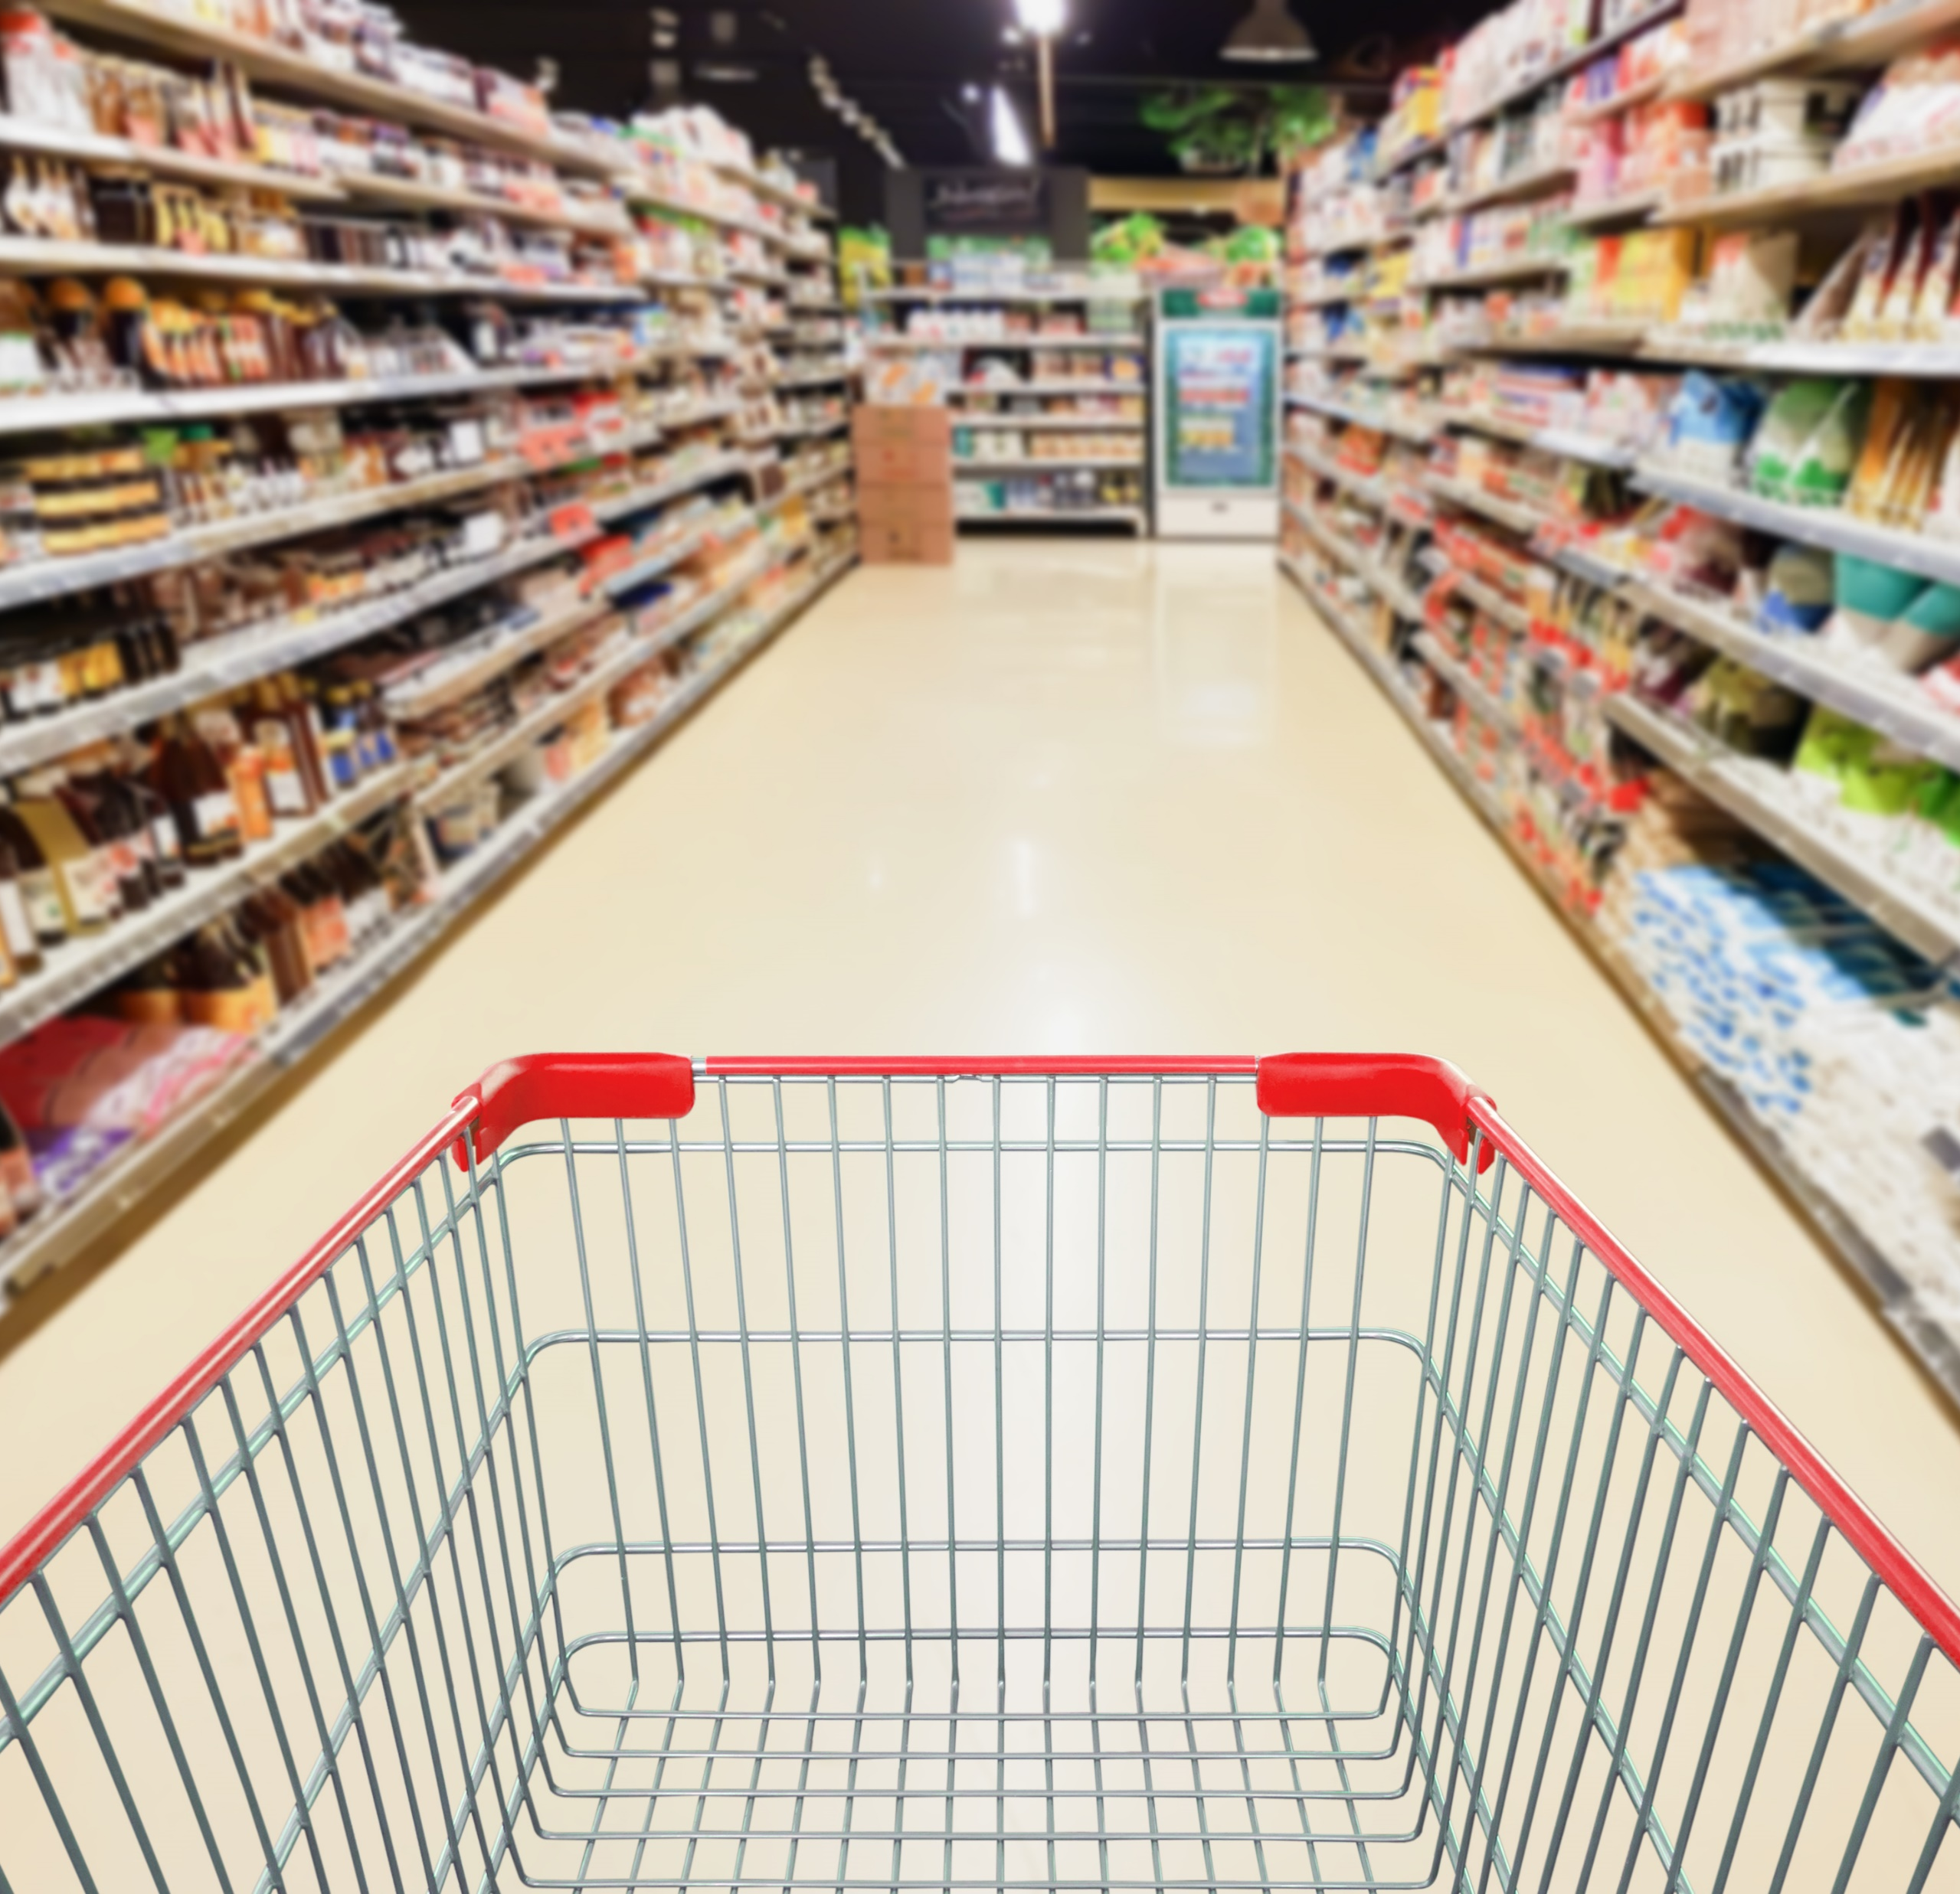
1 |
Investment proposition
2 |
Market context
3 |
Strategic focus
4 |
H1 2022 results
5 |
FY 2022 outlook
Macroeconomic context and markets
Strategy and focus
Analysis of the results | Margin optimization and Own Brands growth
4. Markets and ESG details
Appendixes

Slide 4
2. Strategy and Focus - AQUILA Strategy for Profitable Growth
Reduce carbon footprint by 10% by 2026
M&A approach
Margin optimization
Key criteria for mergers and acquisitions:
Targets: FMCG distributors and brand manufacturers.
Potential synergy through products portfolio and operational model.
Always initial majority stake, with option to buy in 3-5 years for tickets over EUR 50 m.
Cross-selling of our products across channels and clients.
Focus on the frozen product segment, both in terms of distribution and logistics.
Increasing presence in the channels with higher margins (HoReCa, Gas station).
Key actions:
Own brands growth
ESG strategy
03
04
Sustained sales growth (+33% in the first 9 months of 2023 compared to the first 9 months of 2022).
Launching new products (22 products in 2023).
Focus on HoReCA (+15% in the first 9 month of 2023).
Increasing retail presence.
Environment and climate change.
Human capital and communities.
Ethics and governance.
2022-2026 strategic directions:
Key steps:
4
Presentation of financial results 9 months 2023

Slide 5
M&A Negotiations Status
Target¹ | Activity | Sales² | EBITDA | Negotiation stage
Target 1 | Production | EUR 35m. | EUR 9m. | Price negotiation
Target 2 | Production | EUR 35m. | EUR 6.5m. | Prospecting
Target 3 | Distribution | EUR 34m. | EUR 2m. | DD
Target 4 | Production | EUR 36m. | EUR 1.3m. | Prospecting
Target 5 (Romtec) | Production | EUR 5.2m. | EUR 0.7m. | Purchase-sale pre-agreement
Target 6 | Production | EUR 8.4m. | EUR 0.6m. | NBO
Target 7 | Distribution | EUR 7.5m. | N/A | Prospecting
01
02
03
03
04
05
06
07
¹ Target in descending order of EBITDA value; ² Source: EMIS; * FY 2021 (individual RAS);
5
Presentation of financial results 9 months 2023

Slide 6
Margin optimization
01
Product portfolio
Digitization
03
Optimizing the current portfolio, focusing on higher margin products, including own brands.
Increasing the number of SKUs, mainly on existing customer.
Focusing on the frozen product portfolio (33% growth in own brands in the first 9 months of 2023).
The implementation of the new ERP, with a targeted implementation deadline in 2024, will provide stricter internal control, increased reporting capabilities, as well as enhanced integrations with external software (WMS, TMS).
Expansion of automation solutions in distribution and logistics in the next 3 years to increase productivity, with a clear impact on the profit margin. The pick-by-light solution expanded with 1.500 pallet locations in the first 9 months of 2023, AI solutions under testing for pallet manufacturing optimization.
Continuous development of the B2B platform (launched in 2023) over the next 3 years to reduce order time and increase agent productivity. Currently, there are 300 active customers with frequent acquisitions.
02
Focusing on high margins channels
Increasing the penetration degree of the Convenience channel (+16% in the first 9 months of 2023 at gas stations and travel retail).
Growth in the HoReCa (+15% in the first 9 months of 2023) and Gastro channel in modern retail, especially through the portfolio of frozen products and ready meals, and in the future by adding new types of products.
6
Presentation of financial results 9 months 2023

Slide 7
2022 - 2026 Sustainability Strategy
Priorities
Trends and Actions
Human Resources Priorities
Employee recruitment and retention with an emphasis on equal opportunities and increasing diversity.
Digitization.
Other ESG Priorities
The 2022-2026 Decarbonization Plan with the target of -10% greenhouse gas emissions in the strategic period, with 2021 as the reference year.
The gradual bringing of the fleet to the Euro 6 standard and the replacement of cars equipped with petrol and diesel engines with cars equipped with alternative propulsion engines, LPG or Hybrid.
Trend - labor force deficit in Romania is caused by the demographic decline, the negative balance of international migration, and by the demographic aging process.
Actions and effects
Actions for employee retention (the fluctuation rate forecast for the year 2023 is down by 3.77 percentage points compared to the fluctuation rate recorded in 2022).
Maintaining and gradually increasing the workforce from non-EU countries (in the first 9 months of 2023 we have a number of 92 employees who come from the non-EU area). In the upcoming period, we will further increase the number of foreign employees by at least 60 individuals, reaching approximately 150 employees of nationalities other than Romanian.
Increase in the number of women employed (39.7% women in the first 9 months of 2023 compared to 39.4% in the first 9 months of 2022).
7
Presentation of financial results 9 months 2023

Slide 8
1 |
Investment proposition
2 |
Market context
3 |
Strategic focus
4 |
H1 2022 results
5 |
FY 2022 outlook
Macroeconomic context and markets
Strategy and focus
Analysis of the results | Margin optimization and Own Brands growth
4. Markets and ESG details
Appendixes

Slide 9
3. Analysis of results - Key performance indicators
(9 months 2023)
Sales RON 1,757m. | EBITDA RON 115.56m. | Net Profit RON 70m.
Sales increase ( y/y) +14% Gross Margin 21.3% | EBITDA increase (y/y) +5% EBITDA Margin 6.6% | Net Profit increase (y/y) +9% Net Profit Margin 4%
Distribution Sales RON 1,644m. | Logistics Sales RON 64m. | Transport Sales RON 49m.
9
Presentation of financial results 9 months 2023

Slide 10
Financial Results 9 months 2023
RON m. | 9M 2023 | 9M 2022 | Variation
Revenues | 1,757 | 1,543 | 14%
Cost of goods sold | (1,294) | (1,125) | 15%
Gross Profit | 350 | 310 | 13%
EBITDA | 116 | 110 | 5%
Net Financial Result | 6 | 3 | 106%
Profit before tax | 86 | 74 | 16%
Income tax expense | (16) | (9) | 66%
Profit for the year | 70 | 64 | 9%
9 months 2023 vs. 9 months 2022
Total revenues increased by approx. 14% compared to the same period in 2022, reaching RON 1,757m.
The achieved results were primarily supported by the growth in revenues from the distribution business segment, which accounts for over 94% of the company's turnover.
The gross margin from goods sold increased by approximately RON 40m, with a 13 percentage point advance, and remained constant at around 21%.
Net profit of the company increased by 9%, to RON 70m.
10
Presentation of financial results 9 months 2023

Slide 11
Sales by segments 9 months 2023
DISTRIBUTION
Sales revenue, RON m.
Distribution revenues growth of 15% in the first 9 months of 2023 compared to the same period in 2022, this is mainly attributed to the organic growth of this business line across the three sales channels: traditional by 27%, HoReCa by 15%, and gas stations and convenience stores by 16%.
⬆ 14%
⬆ 15%
LOGISTICS
⬆ 12%
Revenues from logistics services increased by 12% compared to the same period in 2022 as a result of tariff indexing.
⬆
5%
TRANSPORT
Revenue from transportation services decreased by 5%, compared to the same period in 2022, mainly due to a 4% decrease in the number of kilometers.
11
11
Presentation of financial results 9 months 2023

Slide 12
Sales by channel
Revenues by channel 9 months 2023, RON m.
Revenues by channel 9 months 2022 vs. 9 months 2023, RON m., %
+13%
+16%
+15%
(4)%
+27%
Total: 1,642
12
12
Presentation of financial results 9 months 2023

Slide 13
Opex and D&A expense 9 months 2023
Operating and D&A expenses, RON m.
9 months 2023 vs. 9 months 2022
Operating expenses before depreciation increased by RON 39m.
The biggest increases were determined by the increase in expenses with employee benefits by RON 24m., (+19% increase in average employee cost).
The downward trend in fuel prices has led to corresponding cost reductions.
13
Presentation of financial results 9 months 2023

Slide 14
Evolution of Liquidity Indicators
26%
(3)%
7%
Days of Inventory (DIO) increased mainly due to seasonality (DIO September 2022 - 47 days).
Days Sales Outstanding (DSO) registered a decrease as a result of reduced exposure in the organized retail channel (DSO September 2022 – 44 days).
Days Payable Outstanding (DPO) increased mainly due to seasonality and the supplier mix (DPO September 2022 - 63 days).
14
Presentation of financial results 9 months 2023

Slide 15
Main elements of the Balance Sheet
RON | Sep. 30, 2023 | Dec. 31, 2022 | Variation
Non-current assets | 293,094,616 | 234,879,109 | 25%
Tangible and intangible assets | 241,489,754 | 178,112,582 | 36%
Current assets | 663,150,646 | 619,003,214 | 7%
Inventories | 207,247,638 | 158,430,373 | 31%
Trade receivables | 248,996,581 | 247,816,687 | 0.5%
Total assets | 956,245,262 | 853,882,323 | 12%
Total equity | 506,439,239 | 483,821,517 | 5%
Liabilities | 449,806,023 | 370,060,806 | 22%
Total equity and liabilities | 956,245,262 | 853,882,323 | 12%
Non-current assets increased by RON 58m. primarily due to the extension of operational leasing contracts with an impact on Right of Use assets.
Current assets decreased by approximately RON 65m., mainly due to a 31% increase in inventories.
Equity increased by 5%.
15
Presentation of financial results 9 months 2023

Slide 16
Evolution of Own Brands – significant growth (+33%)
Own Brands by volume 9 months 2022 vs. 9 months 2023 ('000 KG)
⬆ 22%
⬆ 8%
The revenues related to the own brands, Gradena, La Masă and Yachtis, had an advance of 33% in the first 9 months of 2023, up to RON 64 m.
LaMasă brand (ready meals), which currently includes 14 types of products, is available in new specially designed packaging, gradually, starting from July 2022, and the products can also be found in Retail, starting with the fourth quarter of 2022.
The extension of the Gradena brand (frozen fruits and vegetables) with 8 new products in 2023. We launched a TV campaign in the fourth quarter of 2023 to increase visibility and strengthen the brand positioning strategy.
The Yachtis brand (frozen fish and seafood products) has launched a total of 14 products in the first 9 months of 2023.
Own Brands by value 9 months 2022 vs. 9 months 2023 ( RON m.)
⬆ 17%
⬆ 58%
16
Presentation of financial results 9 months 2023

Slide 17
1 |
Investment proposition
2 |
Market context
3 |
Strategic focus
4 |
H1 2022 results
5 |
FY 2022 outlook
Macroeconomic context and markets
Strategy and focus
Analysis of the results | Margin optimization and Own Brands growth
Markets and ESG details
Appendixes

Slide 18
FMCG and HoReCA distribution market grew 61.2% in the last 5Y reaching EUR 5b/RON 25b in 2022
Romania: FMCG & HoReCA distribution market¹
Romania: FMCG & HoReCA distribution market concentration¹
¹ Source: KeysFin;
18
Presentation of financial results 9 months 2023

Slide 19
FMCG and HoReCa distribution market I Top players
Top players by turnover¹, in RON m. (2022)
The second largest player
The turnover of the players from FMCG and HoReCa from România increased by 18% in 2022 vs 2021, to the record level of RON 25.3 billion.
Top players by profit¹, in RON m. (2022)
AQUILA is well-positioned to capture growth opportunities both organically and through acquisitions within a fragmented distribution market.
The top 10 players weigh 52% of the total turnover of the FMCG distributors from Romania.
¹ Source: KeysFin;
19
Presentation of financial results 9 months 2023

Slide 20
Exposure to a large addressable market |
FMCG & HoReCa markets expected to expand at 5Y GAGR of 5% (cumulated)
Modern and Traditional Trade to advance at 5Y CAGR of +5.5% and -0.2% respectively, by 2026¹
HoReCA to advance at 5Y CAGR of +13% by 2026¹
¹ Source: Euromonitor Internațional
20
Presentation of financial results 9 months 2023

Slide 21
Convenience stores, Discounters and Supermarkets expected to outperfom within Modern Trade
Modern Trade by segments ¹
¹ Source: Euromonitor International
21
Presentation of financial results 9 months 2023

Slide 22
2022 - 2026 Sustainability Strategy
The 2022-2026 Decarbonization Plan, which includes scenarios and projects to reduce the impact on the environment, the analysis of associated risks and opportunities.
Actions taken:
Determining the carbon footprint, utilization of the "GHG Protocol Corporate Accounting and Reporting Standard" for Scope 1 and 2, and "GHG Protocol Corporate Value Chain Standard for Scope 3 emissions.
Analysis of water consumption and water stress, using the World Resource Institute Aqueduct methodology.
Incorporating selection criteria that also use ESG elements, with the aim of establishing decarbonization targets for the supply chain in the coming years.
CDP reporting: Climate Change and Water Security.
We believe in the sustainable development of our business, and we want to be an example in terms of social and environmental responsibility.
The 2022-2026 Sustainability Strategy, with 2021 as the reference year, was approved and published at the beginning of 2022.
We started implementing the strategy in the following directions:
-Environment
-Employees and communities
-Corporate Governance
22
Presentation of financial results 9 months 2023

Slide 23
ESG Strategy - Environment
ESG Targets
ESG Focus
Our main target: -10% greenhouse gas emissions in the strategic period, with 2021 as the reference year.
Along with the actions included in the Decarbonization Plan, we will also continue the projects started in the last two years:
Gradually bringing the fleet to the Euro 6 standard and replacing cars equipped with petrol and diesel engines with cars equipped with alternative propulsion engines, LPG or Hybrid. In the period 2021-2022, more than 65 vehicles equipped with LPG or hybrid engines were purchased.
In 2023, we anticipate the purchase of over 80 LPG or Hybrid vehicles. During the same year, we will purchase over 100 vehicles equipped with Euro 6 engines.
Investment in:
Complex logistic solutions, with automation systems and modern order preparation techniques;
Roll containers;
Expansions of the automatization Pick by Light and Pick by Voice implementation;
Mobile shelves in frozen warehouses;
ERP, TMS systems;
Digitization of operational systems;
Semi-automatic wrappers;
LED lighting;
Li-Ion equipment, including in cold store warehouses
Reducing the amount of paper used through digitization, simultaneously with the expansion of the use of recycled paper.
Introducing sustainability principles into the procurement process.
Greenhouse gas emissions GHG 2021:
Scope 1: 24,562.3 eqtCO2
Scope 2 market based: 2,112.4 eqtCO2
Scope 2 location-based: 2,601.7 eqtCO2
Scope 3 capital goods, purchased goods and services, waste, and business travel: 10,162.6 metric tons of CO2e
53% of the electrical energy consumed comes from renewable sources.
In 2022 we invested EUR 220,000 in the first photovoltaic plant, with 560 panels, and a combined capacity of 230 Kw.
89.7% of the total water consumption comes from the public network and is potable, 10.3% comes from drilled wells and complies with the legislation in force.
We have implemented the Program to prevent and reduce the amount of waste generated in accordance with legal requirements, as well as the selective collection in the workplaces.
1
23
Presentation of financial results 9 months 2023

Slide 24
ESG Strategy - Social
ESG Focus
ESG Targets
Occupational health and safety
We kept approx. 3,000 jobs, respecting the specific legislation, paying the related taxes and fees.
Safe and fairly remunerated jobs, specific periodic training, instructions and personal protective equipment (PPE).
Maintaining reduced the job related accidents in 2022 compared to 2021.
Training, development and business resilience
Training and development programs > +4000 hours.
Internal management programs prepare 65 leaders for the rapidly changing market.
Partnership with the Ploiesti Oil and Gas University for internships and scholarships.
Increase in the number of women employed (39.7% women in the first 9 months of 2023 compared to 38.8% in the first 9 months of 2022).
Extra-salary benefits and private medical clinic subscription.
Direct contribution of over RON 17m. per year to the Health Insurance Fund (CNAS).
Communities
Donations and sponsorships in partnership with Ploiesti City Hall and Prahova Community Foundation.
Volunteering and donating > Habitat for Humanity > building homes for underprivileged families​.
In the following 5 years we will focus our efforts on:
Occupational safety and health
"Safe Working Practices" Internal Guide for employees and subcontractors;
Risk assessment for all functions and the development of their control methods;
Implementation of an integrated health, safety and social environment management system (HS-ESMS).
Training, development and business resilience
Performance management system that also contains elements of sustainability – pending implementation;
Increasing the number of participants in internal training courses, diversifying the training offer and learning methods;
Continuous training programs for leaders;
Community
Continuation of donation and sponsorship actions;
Volunteering program for AQUILA employees in support of the local community;
1
24
Presentation of financial results 9 months 2023

Slide 25
ESG Strategy - Governance
ESG Focus
ESG Targets
AQUILA’s corporate culture promotes:
Integrity;
Good corporate governance;
The highest ethical standards based on transparency, fairness and equity;
The company’s Code of ethics and business conduct includes:
Organizational values and applicable principles for maintaining a fair working environment;
Provisions relating to compliance with the requirements of:
Occupational health and safety;
Diversity and non-discriminatory employment;
Conflict of interest, bribery, corruption, discrimination;
Environment protection;
Communication/Complaints;
The Board of Directors consists of 5 members, of which 3 are independent, non-executive.
Composition of the management committees:
BoD: 80% men and 20% women;
Audit Committee: 50% men and 50% women;
Nomination and Remuneration Committee: 50% men and 50% women;
1
AQUILA's efforts for the next 5 years will focus on strengthening internal corporate governance policies, with a focus in the coming year on:
Development of a Cyber Security and Data Privacy protocol;
Drafting a Diversity Policy;
Drafting a Modern Slavery Declaration;
Remuneration Policy;
Road safety code;
Code of Conduct for Suppliers;
Complaints procedures – in progress;
25
Presentation of financial results 9 months 2023

Slide 26
AQUILA Investor Relations:
Jean Dumitrescu – Investor Relations Director
Phone: +40 723 331 942
E-mail: investor.relations@aquila.ro
Website: www.aquila.ro
26
Presentation of financial results 9 months 2023

