Slide 1
Presentation Preliminary
Financial Results -2023 -

Slide 2
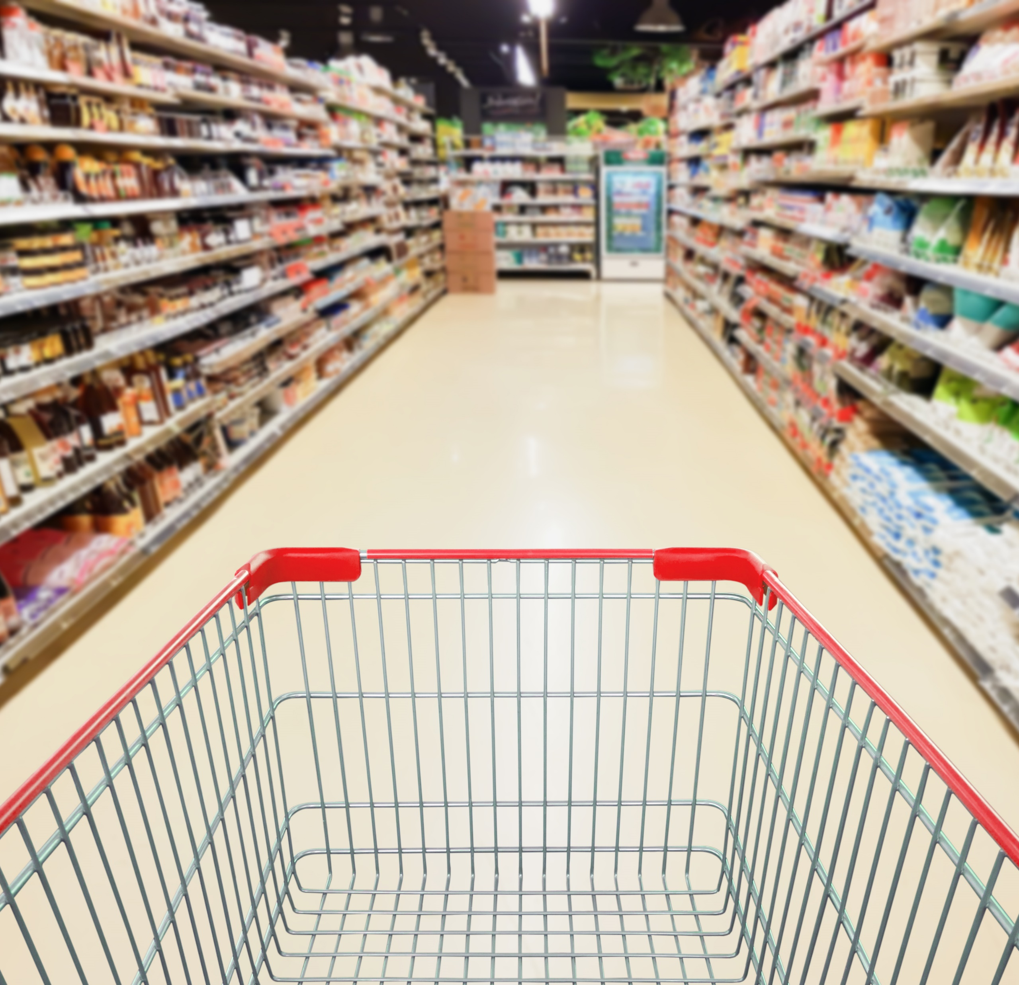
1 |
Investment proposition
2 |
Market context
3 |
Strategic focus
4 |
H1 2022 results
5 |
FY 2022 outlook
Macroeconomic context and markets
Strategy and focus
Analysis of the results | Margin optimization and Own Brands growth
4. Markets and ESG details
Appendixes

Slide 3
1. Macroeconomic Context, markets and trends
Context
Trends
$25B
Annual inflation rate of 6.6% (Dec 2023 vs. Dec 2022) according to NIS, estimated by BNR to reach 4.8% at the end of 2024.
Monetary policy rate 7.0% (starting 11th of January 2023) versus 2% in January 2022.
FMCG retail market is estimated to reach RON 130 billion in 2023 (+3.2%).
HoReCA retail market is estimated to reach RON 19 billion 2023 (+12%).
Inflation and the increase of Traditional, Supermarkets and Convenience from retail, respectively of the HoReCa channels were the main drivers behind the increase in sales.
Decreasing tendency in volume, determined by the repeated increase in prices. The trend of stabilization and slight volume growth in the second half of the year.
Downtrading, especially in large format stores and discounters.
Shopping cart: decreased tendency in value and number of products. The increase in purchase frequency.
Consumer perception: giving up non-essential expenses, looking for offers/discounts. Pragmatic, loyal to brands, private label did not outperform the market.
Sources: Euromonitor, KeysFin, Emis. GFK
3
Presentation of the Preliminary Financial Results for 2023

Slide 4
2. Strategy and Focus - AQUILA Strategy for Profitable Growth
Reduce carbon footprint by 10% by 2026
M&A approach
Margin optimization
Key criteria for mergers and acquisitions:
Targets: FMCG distributors and brand manufacturers.
Potential synergy through products portfolio and operational model.
Always initial majority stake, with option to buy in 3-5 years for tickets over EUR 50 m.
Cross-selling of our products across channels and clients.
Focus on the frozen product segment, both in terms of distribution and logistics.
Increasing presence in the channels with higher margins (HoReCa, Gas station).
Key actions:
Own brands growth
ESG strategy
03
04
Sustained sales growth (+31% in 2023).
Launching new products (+34 products in 2023).
Focus on HoReCA (+15% in 2023).
Increasing retail presence.
2022-2026 strategic directions:
Environment and climate change.
Human capital and communities.
Ethics and governance.
Key steps:
4
Presentation of the Preliminary Financial Results for 2023

Slide 5
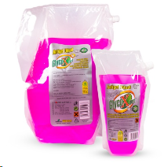
M&A Approach - Romtec Acquisition Status
Acquisition of 100% of the shares of Romtec Europa SRL (Romtec)
Part of Romtec portfolio
Price:
Maximum EUR 3.2 m
Status:
Transaction completed in February 2024.
About the company:
A Romanian company with 30 years of experience in producing liquids and aerosols for car maintenance.
They have over 20 brands, including Jet Xpert, Clima Xpert, and Brake Xpert.
They have a production facility in Iași.
Results for 2022 – Revenue RON 25 m., net profit RON 1.3 m.
4
5
Presentation of the Preliminary Financial Results for 2023

Slide 6
M&A Approach - Parmafood Acquisition Status
The acquisition of 100% of the shares of Parmafood Trading SRL and Parmafood Group Distribution SRL.
Part of the Parmafood portfolio
Price:
Maximum EUR 16.5 m. cumulated
Status:
Approval of the General Shareholders' Meeting - completed.
Competition Council & Commission for the Examination of Foreign Direct Investments - awaiting necessary approvals.
About the company:
Parmafood is one of the leading players in the consumer goods distribution market, covering all channels: HoReCa, Modern Retail, and Traditional Retail.
100 renowned national and international brands.
They operate logistic warehouses with integrated stock management systems.
Results for 2022 – Cumulative revenue of RON 245.5 m. and cumulative net profit of RON 15.6 m. for Parmafood Trading and Parmafood Group Distribution.
6
Presentation of the Preliminary Financial Results for 2023

Slide 7
Margin optimization
01
Product portfolio
Digitization
03
Optimizing the current portfolio, focusing on higher margin products, including own brands.
Increasing the number of SKUs, mainly on existing customers (160 new products in 2023).
Focusing on the frozen product portfolio (31% growth in own brands in 2023).
The implementation of the new ERP, in the process of implementation, it will provide stricter internal control, increased reporting capacity, as well as enhanced integrations with external software (WMS, TMS).
Expansion of automation solutions in distribution and logistics in the next 3 years to increase productivity, with a clear impact on the profit margin. The pick-by-light solution expanded with 1,500 pallet locations in Q1 2023, AI solutions implemented for optimization, pallet assembly, and product image recognition in stores.
Continuous development of the B2B platform (launched in 2023) over the next 3 years to reduce order time and increase agent productivity. Currently, there are 300 active customers with frequent acquisitions.
02
Focusing on high margins channels
Increasing the penetration degree of the Convenience channel (+16% in 2023 at gas stations and travel retail).
Growth in the HoReCa (+15% in 2023) and Gastro channel in modern retail, especially through the portfolio of frozen products and ready meals, and in the future by adding new types of products.
7
Presentation of the Preliminary Financial Results for 2023

Slide 8
2022 - 2026 Sustainability Strategy
Priorities
Trends and Actions
Human Resources Priorities
Employee recruitment and retention with an emphasis on equal opportunities and increasing diversity.
Digitization.
Other ESG Priorities
The 2022-2026 Decarbonization Plan with the target of -10% greenhouse gas emissions in the strategic period, with 2021 as the reference year.
The gradual bringing of the fleet to the Euro 6 standard and the replacement of cars equipped with petrol and diesel engines with cars equipped with alternative propulsion engines, LPG or Hybrid.
Trend - labor force deficit in Romania is caused by the demographic decline, the negative balance of international migration, and by the demographic aging process.
Actions and effects
Actions for employee retention (the fluctuation rate forecast for the year 2023 is down by 4.56 percentage points compared to the fluctuation rate recorded in 2022) and the forecast for 2024 is to maintain the decrease.
Maintaining and gradually increasing the workforce from non-EU countries (in 2023 we have a number of 96 employees who come from the non-EU area). In the upcoming period, we will further increase the number of foreign employees by at least 66 individuals, reaching approximately 160 employees of nationalities other than Romanian.
Increase in the number of women employed (41% women in 2023 compared to 39% in 2022).
8
Presentation of the Preliminary Financial Results for 2023

Slide 9
1 |
Investment proposition
2 |
Market context
3 |
Strategic focus
4 |
H1 2022 results
5 |
FY 2022 outlook
Macroeconomic context and markets
Strategy and focus
Analysis of the results | Margin optimization and Own Brands growth
Markets and ESG details
Appendixes

Slide 10
3. Analysis of results - Key performance indicators in 2023
Sales RON 2,510 m. | EBITDA RON 155 m. | Net Profit RON 97 m.
Sales increase ( y/y) +14% Gross Margin 20.8% | EBITDA increase (y/y) +5% EBITDA Margin 6.2% | Net Profit increase (y/y) +14% Net Profit Margin 3.9%
Distribution Sales RON 2,357 m. | Logistics Sales RON 88 m. | Transport Sales RON 65 m.
10
Presentation of the Preliminary Financial Results for 2023

Slide 11
2023 Preliminary Financial Results Analysis
RON m. | 2023 | 2022 | Variation
Revenues | 2,510 | 2,210 | 14%
Cost of goods sold | (1,866) | (1,624) | 15%
Gross Profit | 491 | 439 | 12%
EBITDA | 155 | 147 | 5%
Net Financial Result | 10 | 4 | 158%
Profit before tax | 116 | 101 | 16%
Income tax expense | (19) | (15) | 26%
Profit for the year | 97 | 85 | 14%
2023 vs. 2022
Revenues increased by 14% driven mainly by the distribution segment, especially by sales through the traditional channel, the HoReCa channel and the proximity channels (gas stations and convenience stores), as well as by own brands.
EBITDA increased by 5% versus 2022, up to RON 155 m.
The Net Profit increased by 14% versus 2022, to RON 97 m., the highest since the setup of the company.
11
Presentation of the Preliminary Financial Results for 2023

Slide 12
Sales by segments in 2023
Sales revenue, RON m.
DISTRIBUTION
Distribution revenues growth of 14% in 2023 compared to 2022, mainly attributed to the organic growth of this business line across the three sales channels: traditional by 24%; HoReCa by 15%, and gas stations and convenience stores by 16%.
⬆ 14%
⬆ 14%
LOGISTICS
⬆ 11%
Revenues from logistics services increased by 11% compared to 2022 as a result of tariff indexing and the increase in volumes for existing clients, as well as new clients such as Hama.
4%
TRANSPORT
Transportation service revenues decreased by 4% compared to 2022 due to a decrease in the number of kilometers.
12
12
Presentation of the Preliminary Financial Results for 2023

Slide 13
Sales by channel in 2023
Revenues by channel in 2023, RON m.
Revenues by channel 2022 vs. 2023, RON m., %
+13%
+16%
+15%
(1)%
Total: 2,354
+24%
13
13
Presentation of the Preliminary Financial Results for 2023

Slide 14
Opex and D&A expense in 2023
Operating and D&A expenses, RON m.
2023 vs. 2022
Operating expenses before depreciation increased by RON 52 m. mainly due to:
The increase of employee benefits related expenses by RON 33 m. (the increase is mainly due to the average employee cost increase, 14%).
14
Presentation of the Preliminary Financial Results for 2023

Slide 15
Evolution of Liquidity Indicators
(6)%
2%
3%
Days of Inventory (DIO) decreased mainly due to the reduction in year-end inventory levels of frozen products and confectionery.
Days Sales Outstanding (DSO) registered an increase due to the higher proportion of receivables in HoReCa and Gas Station sectors, respectively, for clients with longer payment terms.
Days Payable Outstanding (DPO) registered an increase due to the higher proportion of suppliers with longer payment terms.
15
Presentation of the Preliminary Financial Results for 2023

Slide 16
Main elements of the Balance Sheet
RON | 2023 | 2022 | Variation
Non-current assets | 281,650,266 | 234,879,109 | 20%
Tangible and intangible assets | 239,479,633 | 178,112,582 | 34%
Current assets | 721,511,764 | 619,003,214 | 17%
Inventories | 170,979,496 | 158,430,373 | 8%
Trade receivables | 286,415,011 | 247,816,687 | 16%
Total assets | 1,003,162,030 | 853,882,323 | 17%
Total equity | 532,535,890 | 483,821,517 | 10%
Liabilities | 470,626,140 | 370,060,806 | 27%
Total equity and liabilities | 1,003,162,030 | 853,882,323 | 17%
2023 vs. 2022
Non-current assets increased by 20% (by approx. RON 47 m.) based on the renewal of operational lease contracts impacting the Right of Use asset. (IFRS 16).
Current assets increased by 17% (by approx. RON 103 m.) due to the growth of Prepayments.
Long-term liabilities increased by RON 59 m., from RON 91 m. to RON 151 m. mainly due to the extension of operational lease contracts (IFRS 16).
16
Presentation of the Preliminary Financial Results for 2023

Slide 17
Evolution of Own Brands – significant growth
(+31%)
Own Brands, by volume 2022 vs. 2023 ('000 KG)
The revenues related to the own brands, Gradena, La Masă and Yachtis, had an advance of 31% in 2023, up to RON 88 m.
LaMasă brand (ready meals), which currently includes 14 types of products, is available in new specially designed packaging, gradually, starting from July 2022, and the products can also be found in Retail, starting with the fourth quarter of 2022.
The extension of the Gradena brand with 19 new products in 2023, including 15 canned goods for Retail and HoReCa, and 4 frozen vegetables for Retail.
The Yachtis brand (frozen fish and seafood products) has launched a total of 15 products in 2023.
⬆ 18%
⬆ 12%
Own Brands, by value 2022 vs. 2023 ( RON m.)
⬆ 45%
17
Presentation of the Preliminary Financial Results for 2023

Slide 18
1 |
Investment proposition
2 |
Market context
3 |
Strategic focus
4 |
H1 2022 results
5 |
FY 2022 outlook
Macroeconomic context and markets
Strategy and focus
Analysis of the results | Margin optimization and Own Brands growth
Markets and ESG details
Appendixes

Slide 19
FMCG and HoReCA distribution market grew 61.2% in the last 5Y reaching EUR 5b/RON 25b in 2022
Romania: FMCG & HoReCA distribution market¹
Romania: FMCG & HoReCA distribution market concentration¹
¹ Source: KeysFin; EMIS
19
Presentation of the Preliminary Financial Results for 2023

Slide 20
FMCG and HoReCa distribution market I Top players
Top players by turnover¹, in RON m. (2022)
The second largest player
The turnover of the players from FMCG and HoReCa from Romania increased by 17% in 2022 vs 2021, to the record level of RON 25.3 billion.
The second largest player
Top players by profit¹, in RON m. (2022)
AQUILA is well-positioned to capture growth opportunities both organically and through acquisitions within a fragmented distribution market.
The top 10 players weigh 52% of the total turnover of the FMCG distributors from Romania.
¹ Source: KeysFin;
20
Presentation of the Preliminary Financial Results for 2023

Slide 21
Exposure to a large addressable market |
FMCG & HoReCa markets expected to expand at 5Y GAGR of 5% (cumulated)
Modern and Traditional Trade to advance at 5Y CAGR of +5.5% and -0.2% respectively, by 2026¹
HoReCA to advance at 5Y CAGR of +13% by 2026¹
¹ Source: Euromonitor Internațional
21
Presentation of the Preliminary Financial Results for 2023

Slide 22
Convenience stores, Discounters and Supermarkets expected to outperfom within Modern Trade
Modern Trade by segments ¹
¹ Source: Euromonitor Internațional
22
Presentation of the Preliminary Financial Results for 2023

Slide 23
2022 - 2026 Sustainability Strategy
The 2022-2026 Decarbonization Plan, which includes scenarios and projects to reduce the impact on the environment, the analysis of associated risks and opportunities.
Actions taken:
Determining the carbon footprint, utilization of the "GHG Protocol Corporate Accounting and Reporting Standard" for Scope 1 and 2, and "GHG Protocol Corporate Value Chain Standard for Scope 3 emissions.
Analysis of water consumption and water stress, using the World Resource Institute Aqueduct methodology.
Incorporating selection criteria that also use ESG elements, with the aim of establishing decarbonization targets for the supply chain in the coming years.
CDP reporting: Climate Change and Water Security.
We believe in the sustainable development of our business, and we want to be an example in terms of social and environmental responsibility.
The 2022-2026 Sustainability Strategy, with 2021 as the reference year, was approved and published at the beginning of 2022.
We started implementing the strategy in the following directions:
-Environment
-Employees and communities
-Corporate Governance
23
Presentation of the Preliminary Financial Results for 2023

Slide 24
ESG Strategy - Environment
ESG Targets
ESG Focus
Our main target: -10% greenhouse gas emissions in the strategic period, with 2021 as the reference year.
Along with the actions included in the Decarbonization Plan, we will also continue the projects started in the last two years:
Gradually bringing the fleet to the Euro 6 standard and replacing cars equipped with petrol and diesel engines with cars equipped with alternative propulsion engines, LPG or Hybrid. In the period 2021-2022, more than 65 vehicles equipped with LPG or hybrid engines were purchased.
In 2023, we anticipate the purchase of over 80 LPG or Hybrid vehicles. During the same year, we will purchase over 100 vehicles equipped with Euro 6 engines.
Investment in:
Complex logistic solutions, with automation systems and modern order preparation techniques;
Roll containers;
Expansions of the automatization Pick by Light and Pick by Voice implementation;
Mobile shelves in frozen warehouses;
ERP, TMS systems;
Digitization of operational systems;
Semi-automatic wrappers;
LED lighting;
Li-Ion equipment, including in cold store warehouses
Reducing the amount of paper used through digitization, simultaneously with the expansion of the use of recycled paper.
Introducing sustainability principles into the procurement process.
Greenhouse gas emissions GHG 2021:
Scope 1: 24,562.3 eqtCO2
Scope 2 market based: 2,112.4 eqtCO2
Scope 2 location-based: 2,601.7 eqtCO2
Scope 3 capital goods, purchased goods and services, waste, and business travel: 10,162.6 metric tons of CO2e
53% of the electrical energy consumed comes from renewable sources.
In 2022 we invested EUR 220,000 in the first photovoltaic plant, with 560 panels, and a combined capacity of 230 Kw.
89.7% of the total water consumption comes from the public network and is potable, 10.3% comes from drilled wells and complies with the legislation in force.
We have implemented the Program to prevent and reduce the amount of waste generated in accordance with legal requirements, as well as the selective collection in the workplaces.
1
24
Presentation of the Preliminary Financial Results for 2023

Slide 25
ESG Strategy - Social
ESG Focus
ESG Targets
Occupational health and safety
We kept approx. 3000 jobs, respecting the specific legislation, paying the related taxes and fees.
Safe and fairly remunerated jobs, specific periodic training, instructions and personal protective equipment (PPE).
Maintaining reduced the job related accidents in 2022 compared to 2021.
Training, development and business resilience
Training and development programs > +4000 hours.
Internal management programs prepare 65 leaders for the rapidly changing market.
Partnership with the Ploiesti Oil and Gas University for internships and scholarships.
Increase in the number of women employed (41% women in 2023 compared to 39% in 2022).
Extra-salary benefits and private medical clinic subscription.
Direct contribution of over RON 17m. per year to the Health Insurance Fund (CNAS).
Communities
Donations and sponsorships in partnership with Ploiesti City Hall and Prahova Community Foundation.
Volunteering and donating > Habitat for Humanity > building homes for underprivileged families​.
In the following 5 years we will focus our efforts on:
Occupational safety and health
"Safe Working Practices" Internal Guide for employees and subcontractors;
Risk assessment for all functions and the development of their control methods;
Implementation of an integrated health, safety and social environment management system (HS-ESMS).
Training, development and business resilience
Performance management system that also contains elements of sustainability – pending implementation;
Increasing the number of participants in internal training courses, diversifying the training offer and learning methods;
Continuous training programs for leaders;
Community
Continuation of donation and sponsorship actions;
Volunteering program for AQUILA employees in support of the local community;
1
25
Presentation of the Preliminary Financial Results for 2023

Slide 26
ESG Strategy - Governance
ESG Focus
ESG Targets
AQUILA’s corporate culture promotes:
Integrity;
Good corporate governance;
The highest ethical standards based on transparency, fairness and equity;
The company’s Code of ethics and business conduct includes:
Organizational values and applicable principles for maintaining a fair working environment;
Provisions relating to compliance with the requirements of:
Occupational health and safety;
Diversity and non-discriminatory employment;
Conflict of interest, bribery, corruption, discrimination;
Environment protection;
Communication/Complaints;
The Board of Directors consists of 5 members, of which 3 are independent, non-executive.
Composition of the management committees:
BoD: 80% men and 20% women;
Audit Committee: 50% men and 50% women;
Nomination and Remuneration Committee: 50% men and 50% women;
1
AQUILA's efforts for the next 5 years will focus on strengthening internal corporate governance policies, with a focus in the coming year on:
Development of a Cyber Security and Data Privacy protocol;
Drafting a Diversity Policy;
Drafting a Modern Slavery Declaration;
Remuneration Policy;
Road safety code;
Code of Conduct for Suppliers;
Complaints procedures – in progress;
26
Presentation of the Preliminary Financial Results for 2023

Slide 27
AQUILA Investor Relations:
Jean Dumitrescu – Investor Relations Director
Phone: +40 723 331 942
E-mail: investor.relations@aquila.ro
Website: www.aquila.ro

